Slide 1
MGMT 6057 contemporary business management
Module 3: Ethics and social responsibility

Slide 2
Agenda
Definition of business ethics
Identifying ethical organizations
Examples of issues in business ethics
Ethical dilemmas and decisions
Justifications for unethical behavior
(Corporate) social responsibility
Relevance for business owners and project managers

Slide 3
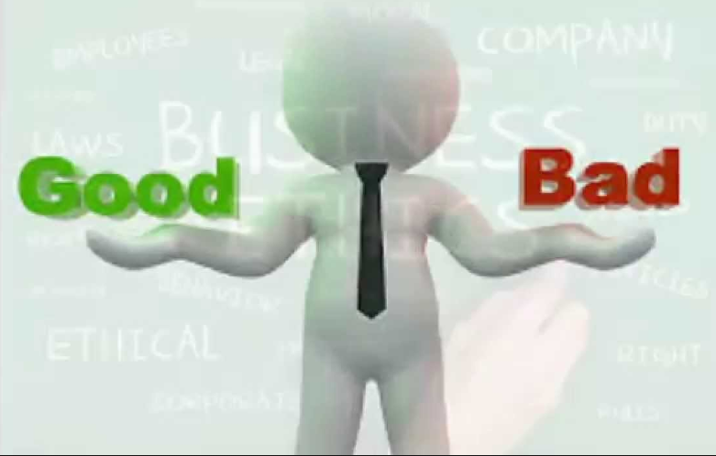
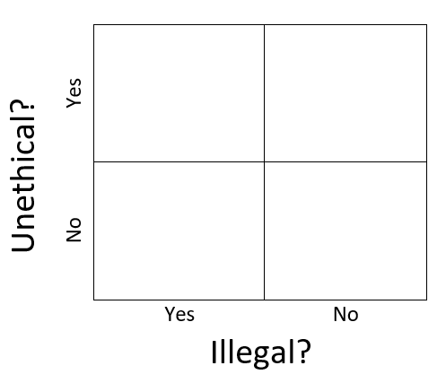
What is business ethics?
Principles of conduct governing appropriate behavior in the business context
Being honest/fair, doing no harm to others, doing what’s right (even though it may put you at disadvantage)
More than obeying the law
Can you think of examples that would fit each box?
Notes:
https://i.ytimg.com/vi/F9TkfFXi30c/maxresdefault.jpg

Slide 4
What is business ethics? (cont’d)
What is ‘the right thing to do’?
Influenced by…
Religious and philosophical perspectives of moral behaviour
Personal factors (e.g., ability to empathize, socio-economic factors)
Socio-Cultural factors (e.g., tradition)
Reflected in laws, company policies, and cultural norms
Modelled/enforced by government authorities (and senior management)

Slide 5
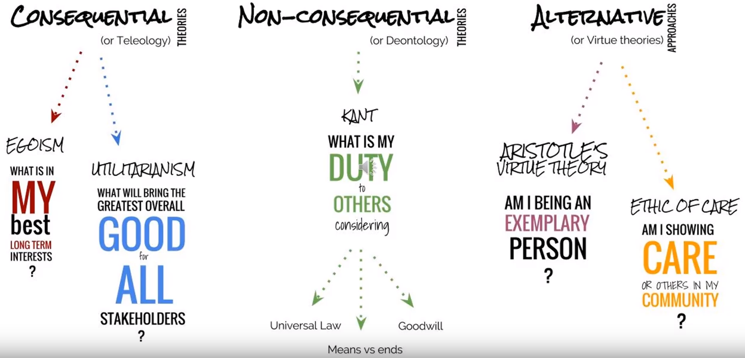
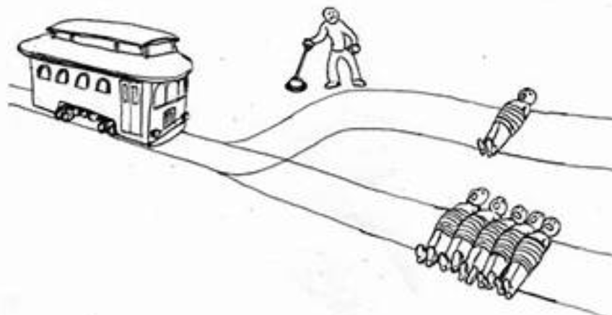
There are many ethical theories/perspectives
The trolley problem…
Notes:
Image Source from Youtube video: https://www.youtube.com/watch?v=Uw7W1PpnbZQ
Trolley image: https://tse1.mm.bing.net/th?id=OIP.lee2wzD5a03N_2cymy145QHaD6&pid=15.1&P=0&w=341&h=181

Slide 6
Example: applying different ethical approaches
Scenario: A parent is poor and stole a loaf of bread to feed his family.
If you adopt a teleological approach to judging this behaviour, you might say that the behaviour was acceptable. The parent has a moral duty to feed his family - “the end justified the means”. Judge the consequence, not the action itself.
If you adopted a deontological approach to judging this behaviour, you might say that stealing is unacceptable. The action of stealing is wrong, regardless of the reason for doing it.
If you adopted a virtue ethics approach to judging this behaviour, you might consider whether the behaviour was virtuous or admirable in terms of the parent’s character. For example, the parent was willing to risk being arrested but he stole the bread because of concern for his children’s health – concern for life is more admirable than concern for a store owner’s profit, so the action is justified.

Slide 7
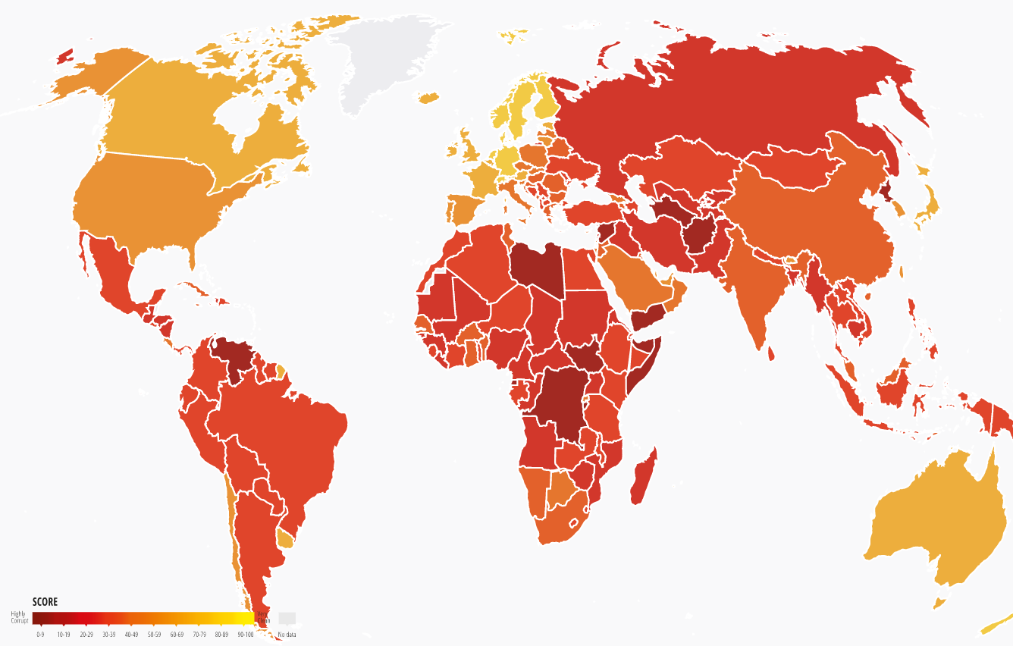
Corruption Perception index (2021)
Notes:
https://www.transparency.org/en/cpi/2020/index/
Perceived levels of public sector corruption

Slide 8
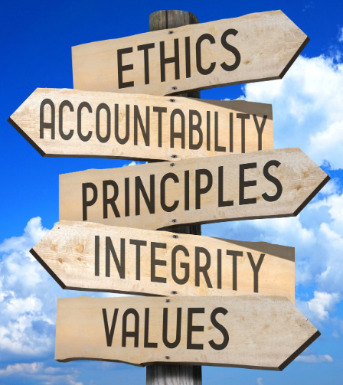
Ethical organizations
Treat employees, customers, investors, and the public fairly
Hold every member personally accountable for his or her action
Communicate core values and principles to all members
Demand and reward integrity from all members in all situations
Notes:
https://www.standardsuniversity.org/wp-content/uploads/ethics-technology.jpg

Slide 9

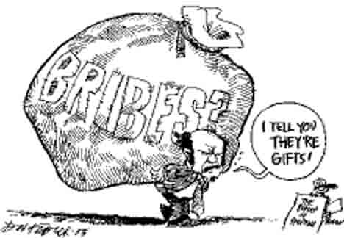
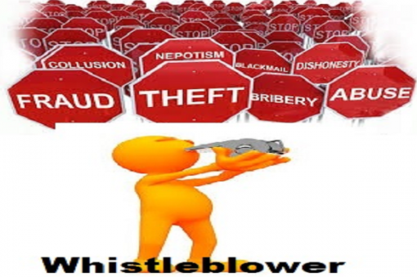
Examples of issues in business ethics
Honesty and Integrity* vs. financial gain
Conflicts of Interest (personal interest vs. company)
Conflicts of Loyalty (friend/family vs. company)
Bribes vs. Gifts
Whistleblowing
* Honesty: one’s relationship with truth
Integrity: one’s relationship with positive morals (broader)
Notes:
https://whatisdigitalmarketing.files.wordpress.com/2013/07/coi.jpg?w=547
http://lawinquebec.com/wp-content/uploads/2015/03/bribes.jpg
http://www.financialwatchngr.com/wp-content/uploads/2017/05/whistle-blowers.png

Slide 10

Ethical dilemmas and decisions
Ethical Dilemma: Choosing between 2+ “acceptable” alternatives that have different impacts for different stakeholders
Ethical Decision: Making a decision knowing that it is right or wrong
Notes:
https://thumbs.dreamstime.com/z/road-sign-arrows-make-your-choice-text-24187102.jpg

Slide 11
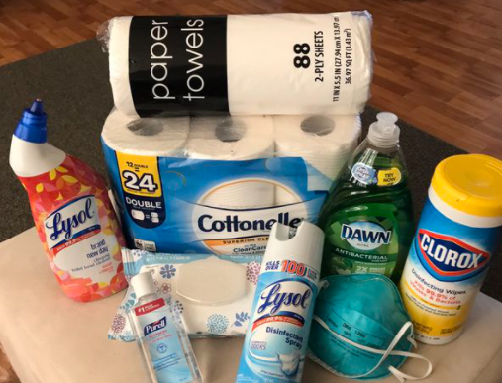









recent events in Canadian business ethics…
Pandemic price gouging
Sears bankruptcy and retirees’ pension plan
SNC-Lavalin face charges of fraud and corruption in Libyan business dealings
Bombardier facing World Bank ban over Azerbaijan corruption allegations
Bakers, grocers involved in 16-year price-fixing conspiracy: Competition Bureau

Slide 12
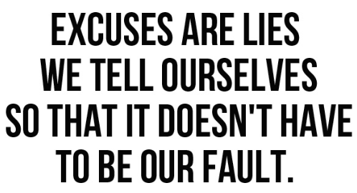

Justifications for unethical behaviour
“It’s not illegal or immoral”
“It’s in everyone’s best interests”
“No one will find out”
“The company will protect me”
AN ALTERNATE approach – ask yourself…
“Will I be embarrassed if my action is written up in the news? Would my family be ashamed of me? If I do this, will I feel badly? Am I being unfair to someone through my actions?”
Notes:
http://chriscreedblog.com/wp-content/uploads/2014/10/Excuses-are-lies.jpg
https://thumbs.dreamstime.com/b/pondering-emoticon-single-finger-thumb-resting-chin-thinking-wondering-ponder-emoticon-103989079.jpg

Slide 13
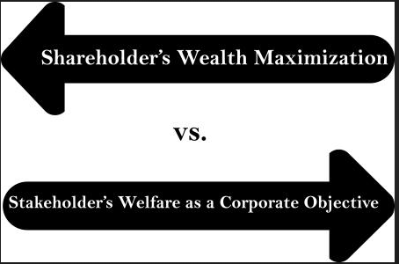

(Corporate) social responsibility
Organizational approach to balancing different stakeholder needs when making legal, economical, ethical, and social decisions
Stakeholders include owners, employees, customers, communities
Stakeholder theory vs. shareholder theory
Supreme Court of Canada supports stakeholder perspective (Boards of Directors have duty to the corporation, not to specific stakeholders)
Notes:
https://www.opentext.com/file_source/OpenText/en_US/PNG/corporate-social-responsibility-at-opentext-web-graphic-485x485.png
https://efinancemanagement.com/wp-content/uploads/2012/02/Art.85.Shareholders-Wealth-Maximization-Vs.-Stakeholder-Welfare-as-a-Corporate-Objective.jpg

Slide 14
Relevance for Business owners and project managers
Risk of breaking the law – fines, imprisonment
Damage to professional/ organizational reputation
Loss of trust from stakeholders
May affect future business opportunities
Important to develop Code of Conduct if employees/team members will be in situations where they face ethical decisions/dilemmas
Project Managers: PMI Code of Ethics & Professional Conduct – guidelines for ethically appropriate behaviour for the project management profession
Project Managers and business owners influence organizational culture through their actions
Emphasis on interests of stakeholders, not just shareholders (owners)

